Slide 1

Feature selection and feature engineering
Tim ajar kecerdasan artifisial

Slide 2

Agenda
Introduction
Feature selection
Feature enginnering

Slide 3

Introduction
Feature selection and feature engineering is an important component of your machine learning pipeline.
Effective feature selection and engineering can significantly impact the performance of a machine learning model by improving predictive accuracy, reducing overfitting, and enhancing interpretability.

Slide 4
Why to lower the amount of input feature
Reduce Multicollinearity
Multicollinearity (alsocollinearity) is a phenomenon observed with features in a dataset where one predictor feature in a regression model can be linearly predicted from the other's features with a substantial degree of accuracy.
Reducing the time
will allow us to run more variations of the models leading to quicker and better results

Slide 5
Why to lower the amount of input feature
easier to explain
When the number of features goes up, the explainability of the model goes down.
Reducing the amount of input features also makes it easier to visualize the data when reduced to low dimensions
the curse of dimensionality
As the number of dimensions increases, the possible configurations increase exponentially, and the number of configurations covered by an observation decreases.
As you have more features to describe your target, you might be able to describe the data more precisely, but your model will not generalize with new data points – your model will overfit the data

Slide 6

One important reason to drop features is the high correlation and redundancy between input variables or the irrelevancy of certain features

Slide 7
Case study: zestimates
There is a real estate site in the US that allows real estate agents and homeowners to list homes for rent or for sale. Zillow is famous, among other things, for its Zestimate. The Zestimate is an estimated price using machine learning. It is the price that Zillow estimates a home will sell for if it was put on the market today. The Zestimates are constantly updated and recalculated.
How does Zillow come up with this number
https://www.kaggle.com/c/zillow-prize-1

Slide 8
List of potential input variable for our machine learning model
Square footage
Number of bedrooms
Number of bathrooms
Mortgage interest rates
Year
Property taxes
House color
Zip code
Comparable sales
Tax assessment

Slide 9
what do you think about the house color?

Slide 10
Features that can be dropped without impacting the model's precision
Redundant:
This is a feature that is highly correlated to other input features and therefore does not add much new information to the signal.
Irrelevant:
This is a feature that has a low correlation with the target feature and for that reason provides more noise than signal.

Slide 11
Feature selection
Feature selection refers to the processs of the selecting subset of relevant features from the original features set while removing irrelevant or redundant features.
Various techniques, such as filter methods, wrapper methods, and embedded methods, are used to determine feature importance
Feature selection is important as it reduces dimensionality, improves model interpretability, speeds up training, helps alleviate the curse of dimensionality, prevent overfitting, and enhances generalization.

Slide 12
Exploratory data analysis
exploratory data analysis can be a good way to get an intuitive understanding and to obtain insights into the dataset we are working with.
Three approaches that are commonly used :
Feature importance
Univariate selection
Correlation matrix with heatmap

Slide 13

Feature importance

Slide 14
Feature importance
The importance of each feature of a dataset can be established by using this method.
Feature importance provides a score for each feature in a dataset. A higher score means the feature has more importance or relevancy in relation to the output feature.
Feature importance is normally an inbuilt class that comes with Tree-Based Classifiers.
In the following example, we use the Extra Tree Classifier to determine the top five features in a dataset

Slide 15
Feature importance
Download train.csv (https://bit.ly/3ELORg2)
Open google colab

Slide 16
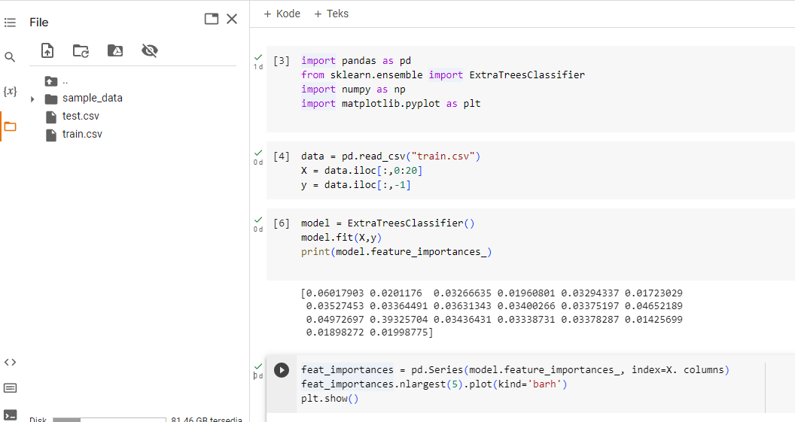
Feature importance

Slide 17
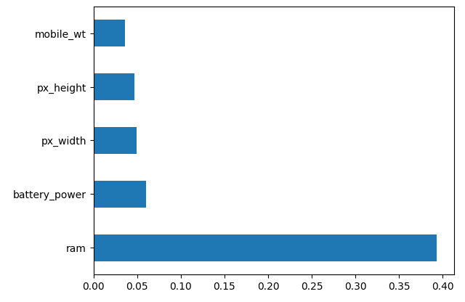
output

Slide 18
Univariate selection

Slide 19
Univariate feature selection
Univariate feature selection evaluates each feature independently, considering its relationship with the target variable to identify the most revelant features.
Univariate feature selection is computationally efficient, interpretable, and particularly useful for identifying highly informative single features. It is also less susceptible to overfitting compared to multivariate approaches.
Statistical tests can be used to determine which features have the strongest correlation to the output variable.
The scikit-learn library has a class called SelectKBest that provides a set of statistical tests to select the K "best" features in a dataset.
The following is an example that uses the chi-squared (chi²) statistical test for non-negative features to select the five best features in an input dataset

Slide 20
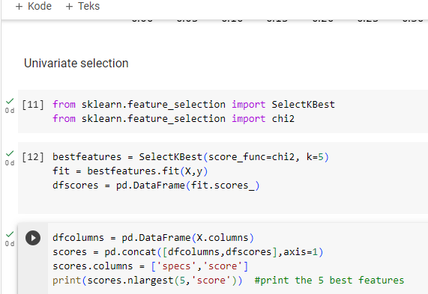
Univariate selection

Slide 21
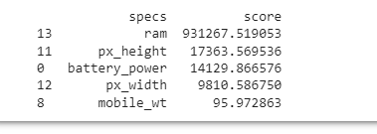
output

Slide 22
Correlation matrix with heatmap

Slide 23
Correlation matrix with heatmap
A correlation exists between two features when there is a relationship between the different values of the features
If a feature changes consistently in relation to another feature, these features are said to be highly correlated.
Correlation can be positive (an increase in one value of a feature increases the value of the target variable) or negative (an increase in one value of a feature decreases the value of the target variable).

Slide 24
Correlation is a continuous value between -1 and 1:
If the correlation between two variables is 1, there is a perfect direct correlation.
If the correlation between two features is -1, a perfect inverse correlation exists.
If the correlation is 0 between two features, there is no correlation between the two features.

Slide 25
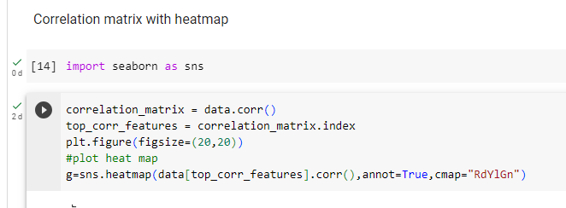
Correlation matrix with heatmap

Slide 26
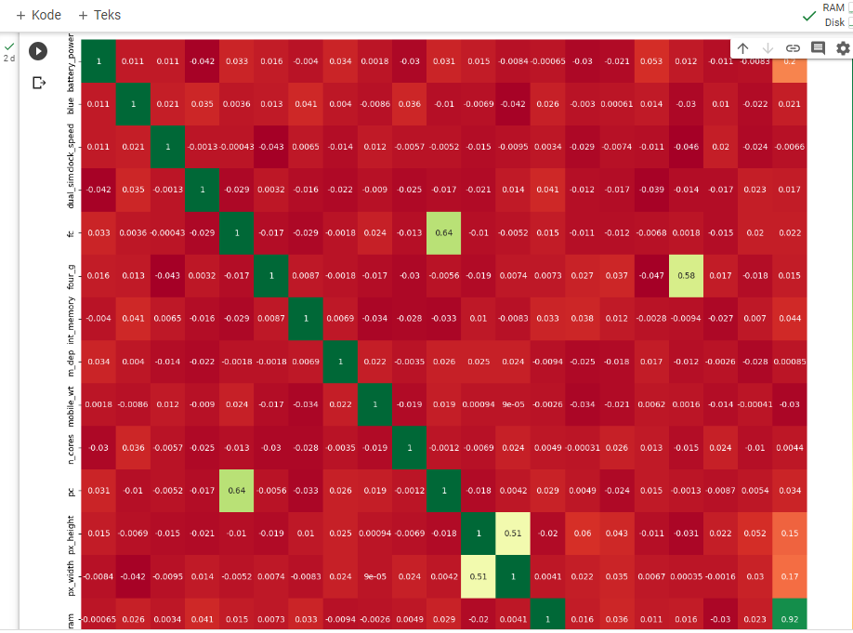
output

Slide 27
Feature engineering
Feature engineering involves creating new features or transforming existing ones to enhance the performance of machine learning models.
Techniques like polynomial expansion, binning, log transformations, one-hot encoding, and feature scaling are commonly used in feature engineering to capture non-linear relationships, handle missing data, and normalize features.
Feature engineering is crucial as it allows the extraction of meaningful information from raw data, improves model performance, enhances interpretability, and caters to specific domain knowledge requirements

Slide 28
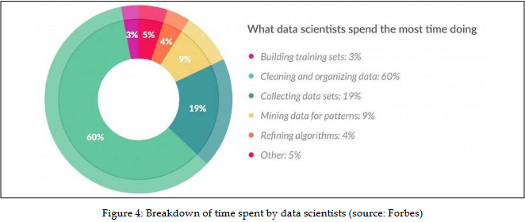
Feature engineering
According to a recent survey performed by the folks at Forbes, data scientists spend around 80% of their time on data preparation

Slide 29
Feature engineering
There are also some generic data science techniques that can be applied in data preparation and feature engineering:
Imputation
Outlier management
One-hot encoding
Log transform
Scaling
Date manipulation

Slide 30
imputation
There might be many reasons why values are missing, such as inconsistent datasets, clerical error, and privacy issue.
Having missing values can affect the performance of amodel, and in some cases, it can bring things to a screeching halt since some algorithms do not take kindly to missing values.
There are techiques to handle missing values, includes:
Removing the row with missing values
Numerical imputation
Categorical imputation

Slide 31


Thank you

